Slide 1
artlook Houston
Admin Training
October 24, 2019

Slide 2
Agenda
Admin Training, 12:00pm - 3:00pm
artlook Admin Mindsets
Timeline
Site Configuration and Launch Checklist
Strategy Session
Technical training
Questions and discussion

Slide 3
Goals
Provide the coaching, tools, and resources that local project leaders need to galvanize support and ensure ongoing, wide-scale platform engagement.
Know the short-term and long-term artlook timeline for Houston
Have a detailed understanding of how artlook works, both from the end user’s perspective and the admin’s perspective
Develop a shared understanding of each person’s role in platform administration and stakeholder engagement
Feel energized about the upcoming milestones

Slide 4
Goals
What are your goals for this meeting?
I have questions / am curious about _________________.
Today will be successful if _________________.

Slide 5
artlook Admin Mindsets
Understanding “end users”
Problem solving
Strategic thinking
Adaptability
Portal proficiency

Slide 6
artlook Houston Timeline
Y1: Initial platform configuration, socialization, and launch
Ongoing | Stakeholder engagement and platform socialization
October 29 - November 8 | Final Houston site configurations (i.e., integrate branding, upload data, deploy to production)
Week of November 11 | Partner / school portal soft launch
TBD | Partner / school portal full, public launch
Early 2020 | Map launch

Slide 7
artlook Houston Timeline
Y2: Begin yearly cadence of activities
Early 2020 | Launch public-facing map Retrospective + Y2 Planning
Spring 2020 - Fall 2021 | AGC Exchange -- early 2020 Year 2 data collection -- late spring to summer 2020 Updated Year 2 artlook map -- early fall 2020 AGC Exchange -- early 2021 Year 3 data collection -- late spring to summer 2021 Updated Year 3 artlook map -- early fall 2021

Slide 8
Site Configuration and Launch Checklist
Provide final schools and partners data
Schools
General information
Survey respondent
Staffing
Courses
Partners
General information
Contacts

Slide 9
Site Configuration and Launch Checklist
Confirm artlook whitelisting with school district
Finalize artlook Houston branding
Round 1 feedback
Round 2 feedback
Determine initial schools survey close date
Ingenuity integrates Houston configurations and uploads data
Ingenuity tests Houston staging site and then deploys to production
Ingenuity provides Houston claim account URLs
Organize school / partner portal soft launch
Organize school / partner full, public launch

Slide 10
Strategy Session
Platform administration
Who are the people and/or organizations responsible for administration of the artlook platform?
What specific roles and responsibilities should be assigned to each person and/or organization?
How will these people and/or organizations communicate and collaborate with each other?

Slide 11
Strategy Session
Survey respondents
Who will complete the survey for each school? What challenges, if any, might this present?
Will you need to implement processes for updating survey respondent information? Who will be responsible for this?
What supports do your survey respondents need before, during, and after the survey launch?

Slide 12
Strategy Session
School / district structure
Do any school / district structures present challenges or complexity that should be considered?
Will you administer the survey to any charter schools or alternative learning centers? Do these schools require special support or outreach?
Are there any “multi-campus” schools in your district? How will you communicate about the survey to these schools?

Slide 13
Strategy Session
Driving engagement
What strategies can you use to ensure high engagement (i.e., high schools survey response rates)?
Who will be responsible for developing and disseminating communications materials? How often will you send communications and reminders?
What existing communications channels and forums can you use for raising awareness and educating stakeholders?

Slide 14
Goals Review
Provide the coaching, tools, and resources that local project leaders need to galvanize support and ensure ongoing, wide-scale platform adoption.
Know the short-term and long-term artlook timeline for Maryland
Have a detailed understanding of how artlook works, both from the end user’s perspective and the admin’s perspective
Develop a shared understanding of each person’s role in platform administration and stakeholder engagement
Feel energized about the upcoming milestones

Slide 15
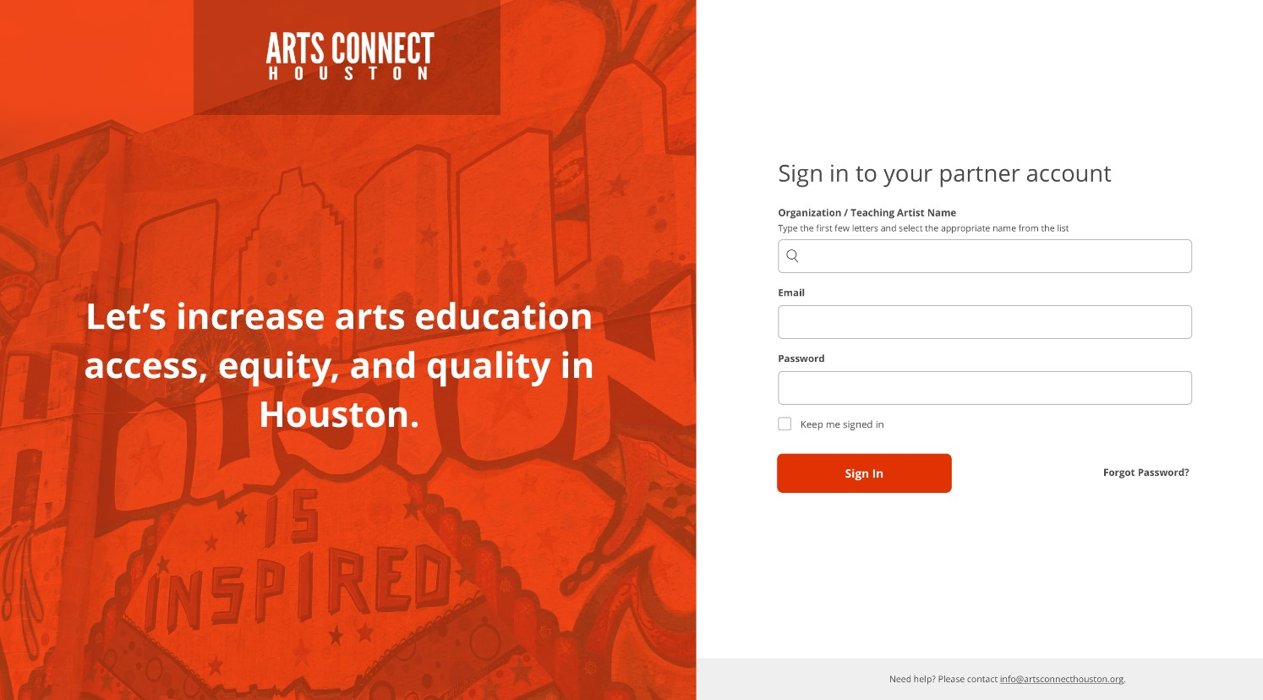

Slide 16
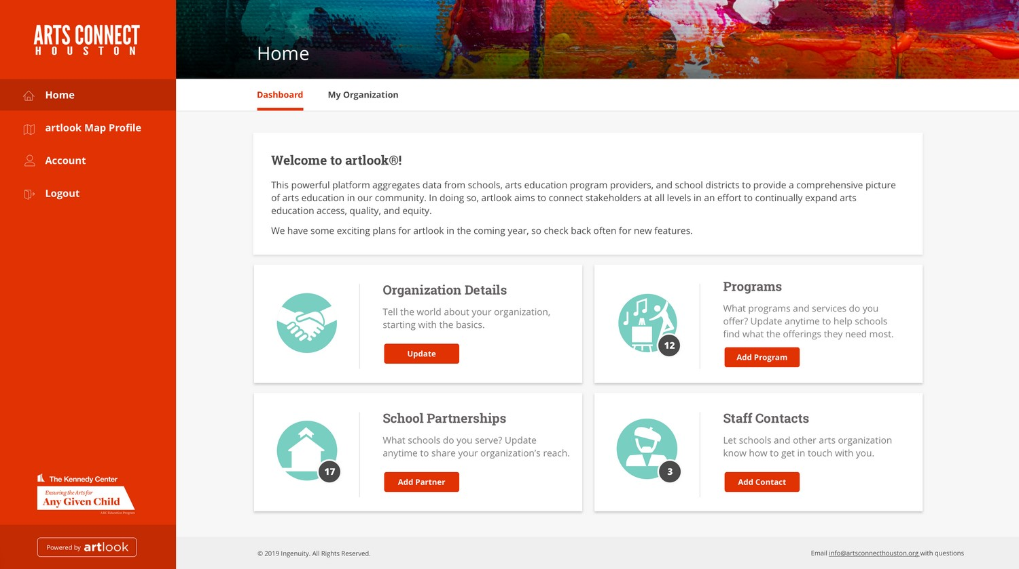

Slide 17
Questions and Discussion
Tom Bunting
Manager, Data Strategy & Products
tb@ingenuity-inc.org
Chloe Patton
Project Manager
cp@ingenuity-inc.org
Steve Shewfelt
Director, Data & Research
ss@ingenuity-inc.org
Paul Sznewajs
Executive Director
ps@ingenuity-inc.org

