Slide 1
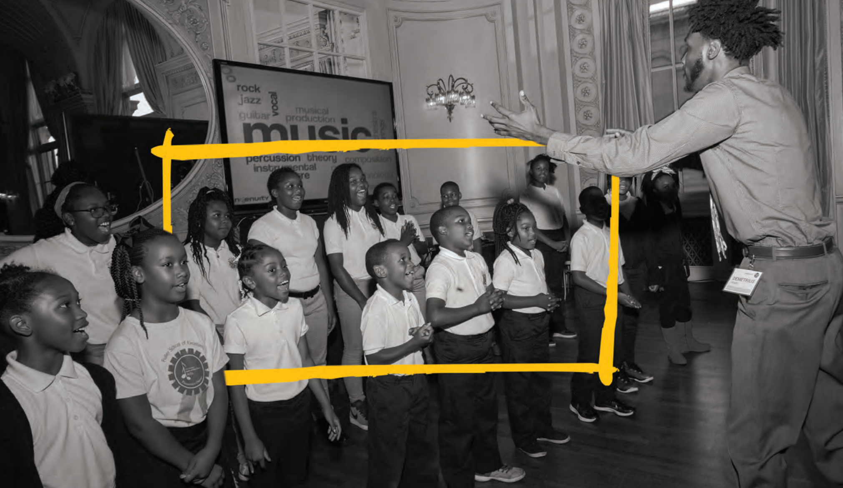
artlook
[Your logo]
The Thinking Behind Arts Learning

Slide 2
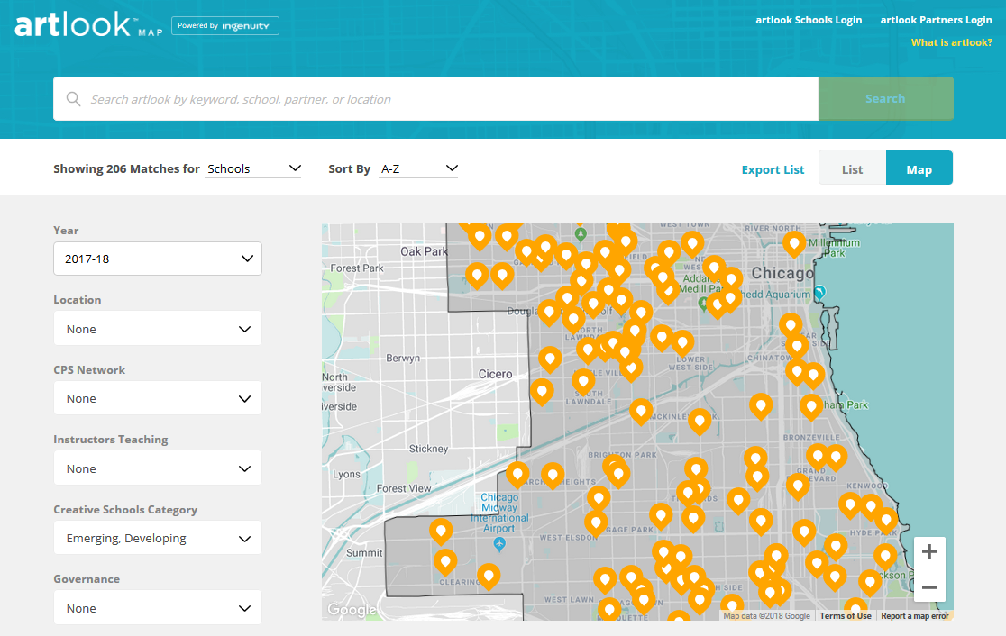
www.artlookmap.com
1
Drive change on the ground
2
Drive systems change
3
Unify data
Notes:
There are three things artlook does to support our community’s vision for collective impact:
Drive change on the ground: This is all about providing tools and resources to our “on the ground” stakeholders—including teachers, principals, and program managers at local arts education organizations— to help them to their jobs better. One of the important use cases here is that teachers can (1) identify a gap in arts education at their school, then (2) go to artlook to search for the programming, resources, or professional development they need to address that gap.
Drive systems change: The second that artlook does is drive systems change. It does this by providing systemic insights to high-level stakeholders, including school leadership, policymakers, funders, and executive directors of arts program providers. An example of such an insight might be the percentage of schools that are offering the appropriate amount of weekly arts instruction.
Unify data: By bringing together—in a single database—annual survey data (from schools and arts partners) with administrative data from CPS (things like HR staffing files, lists of school course offerings), artlook provides a comprehensive picture of arts education in Chicago.

Slide 3
More than School Impact
NATIONAL POLICY
Creates a rising tide of data that can empirically create and inform national arts policy and funding.
STATE POLICY & FUNDING
Use data to inform and leverage statewide arts education policy and funding for school districts.
LEARNED IMPACT
FOUNDATIONS & CORPORATIONS
Data leverages the value and impact of grants across neighborhoods via cohesive & measureable giving outcomes.
BACKBONE AGENCIES
Data guides all systems-level programs and strategies for each city.
HUNDREDS OF CULTURAL AGENCIES
Data transforms cultural agency programs—less planning time, more connections, and higher impact partnerships.
SCHOOLS & STUDENTS
Data drives long-awaited equity for student arts access across schools and neighborhoods.

Slide 4
artlook® Outcomes
artlook® Benefits are Universal
Funders
Targeted funding strategies to advance equity in arts education access
See data on grantees impact in real time
Streamline grant application & reporting
Cities, Counties & States
Backbone Orgs
Set sector-wide goals, advocacy agendas, and plans based on gaps surfaced in the data
Accelerate progress for schools and arts agencies
Instant data infrastructure for collective impact work
Increased collaboration, communication, and accountability
Schools
Build and sustain strong arts programs – with public accountability
Secure partnerships and resources custom to each school‘s needs
Districts
Arts Agencies
Reduce staff time needed to match with schools and build new partnerships
Market programs to schools and funders
Reduce grant reporting time

Slide 5
artlook® Outcomes
artlook® Research & Evaluation Opportunities
Open new frontiers in arts education research at national scale.
Local Impact:
To what extent are local policies, activities, and efforts driving change in access to arts education?
What is the aggregated impact of local investments in cities and counties over time?
How do cities compare to each other and to national averages?
New Arts Research Frontiers:
Is there a correlation between arts education access and indicators we care about in education (ex. attendance, test scores, graduation rates)?
Randomized Controlled Trial - in partnership with a college or university to study academic, social-emotional benefits of arts education (or other)

Slide 6
artlook® Capabilities Expand Over Time
More Cities Joining
Proven, easy-to-use portals for schools and arts organizations to enter uniform data
AGC Dashboard
Ability to track progress and compare measures over time and place
New Features
New features available to all artlook users as they are developed and released
1
Community of Practice
Knowledge sharing among a growing community of AGC backbone agencies
2
3
Research & Analysis
Inform local, state, and federal arts education policy and funding
Improved Policy for All
Data is leveraged to advoacte and improve arts education policies and funding at the local, regional and national level.

Slide 7
artlook® Outcomes
Steps to artlook® Launch
Steps to a [Your City] Launch
What are the steps to launch artlook® in our city?
1
SECURE LEADERSHIP COMMITMENT
Secure the buy-in of key local leaders including School District (Superintendent), Elected Officials (Mayor), Arts Community (leading institutions) and Local Funders.
2
SECURE LOCAL PLANNING TEAM
Reconstitute or convene a new Community Arts Team (CAT) comprised of all key education, cultural, philanthropy and community leaders to serve as the drivers and strategists for the 3-Year initiative.
3
SECURE FUNDING
Identify and secure partial matching funds ($30,000/year x 3 years).
4
ASSEMBLE DATA COLLECTION PLAN
CAT to aid the development of a comprehensive local data collection and communications strategy to aid in the collection of data from district, school, and partner sources.
5
LAUNCH PLATFORM
Launch artlook® over a thee month period.

Slide 8
Technology Partner: Ingenuity
artlook® Outcomes
artlook® Technology Partner: Ingenuity
Ingenuity is a Chicago-based arts education data and advocacy entity, and the developer of the artlook® platform.
Using artlook®, more arts education gains have been achieved in Chicago in the past 5 years than the previous 40.
In partnership with the Kennedy Center for the Performing Arts Ingenuity is piloting artlook® in five select Any Given Child cities over three years (2019-2022). Ingenuity’s four pillars are:
AWARDS AND RECOGNITION
2013 Chicago Innovation Award, Collaboration Category
2013 Boeing Game Changer Award
Frequent presenter at local, state and national conferences
Data and Research
School Leadership and
Professional Learning
Advocacy and Systems Building
Direct Grantmaking

Slide 9
Appendix: Chicago Implementation Outcomes

Slide 10
artlook® Outcomes
Chicago Progress in Arts Education
Achievements in the third-largest school system in the U.S. since 2014
128%
IN CPS SCHOOLS RATED STRONG OR EXCELLING IN THE ARTS
At this rate of increase, over 85% of CPS schools will rate as Strong or Excelling in the arts, provide 2 hours of weekly arts instruction, and staff the arts appropriately in the next three-to-four years.
INCREASE
From 29% to 66%.
27%
IN CPS SCHOOLS STAFFING THE ADEQUATE NUMBER OF ARTS TEACHERS
INCREASE
From 56% to 71%
50%
IN CPS ELEMENTARY SCHOOLS PROVIDING 2 HOURS OF WEEKLY ARTS INSTRUCTION
INCREASE
From 40% to 60%
33%
IN CPS SPENDING ON ARTS EDUCATION – INVESTING AN ADDITIONAL $34MM ANNUALLY
INCREASE
97%
CPS SCHOOLS ARE ACTIVELY ENGAGED IN THE CREATIVE SCHOOLS INITIATIVE
OF ALL

Slide 11
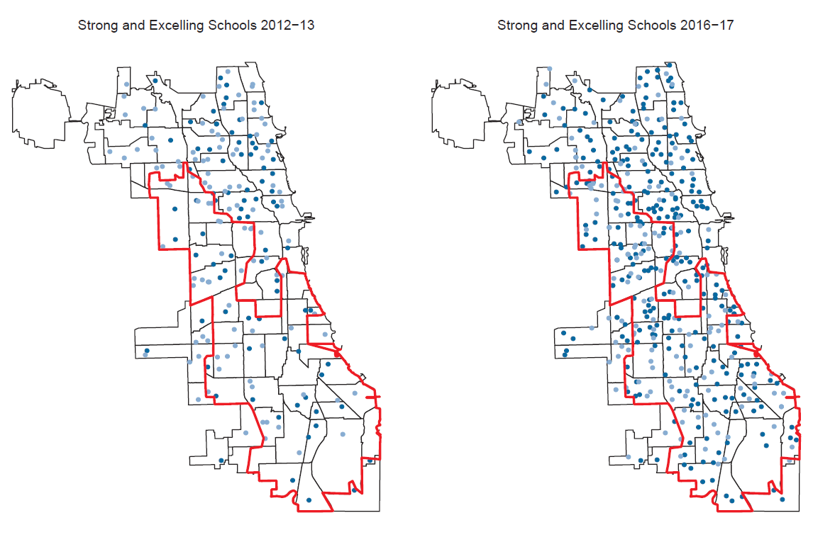
artlook® Outcomes
Growth in under-resourced neighborhoods
Growth in Poor Socio-Economic Neighborhoods

