Slide 1
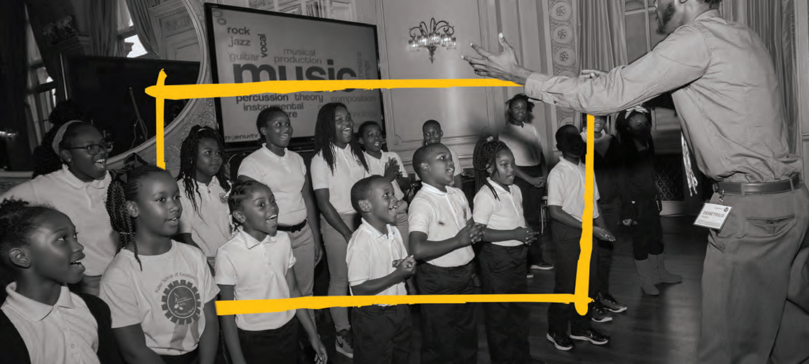
artlook Admin Documentation
Updated 11/4//2019

Slide 2
artlook Admin Mindsets
Understanding “end users”
Problem solving
Strategic thinking
Adaptability
Portal proficiency

Slide 3
artlook Admin Documentation
End User Perspective
These slides will continue to be updated for your reference:
bit.ly/artlookAdminDocumentation

Slide 4
artlook: End User’s Perspective
User onboarding
Each school and organization in your community needs at least one person who will be responsible for sharing data. Prior to launch, Ingenuity receives a list of these people (names and emails) to upload to the artlook database. User onboarding refers to the process of these people claiming their accounts, establishing passwords, and logging in for the first time.
How this works
On launch day, users receive a user onboarding email
Email will include a “claim account” URL (provided by Ingenuity)
Users click on the “claim account” URL
Users are then navigated through the claim account process
Once they have a password, users will be directed to sign in to their accounts
When signing in, users must select their school or organization from the dropdown

Slide 5
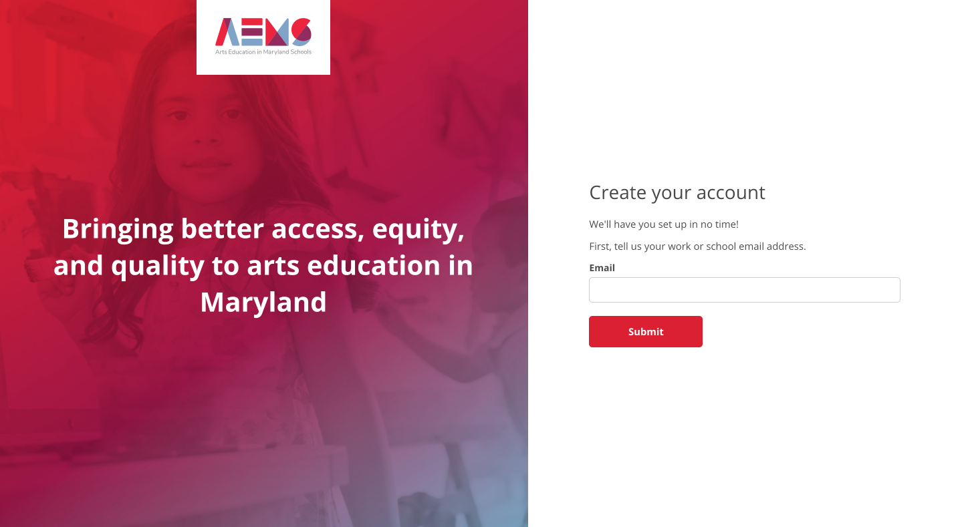

Slide 7
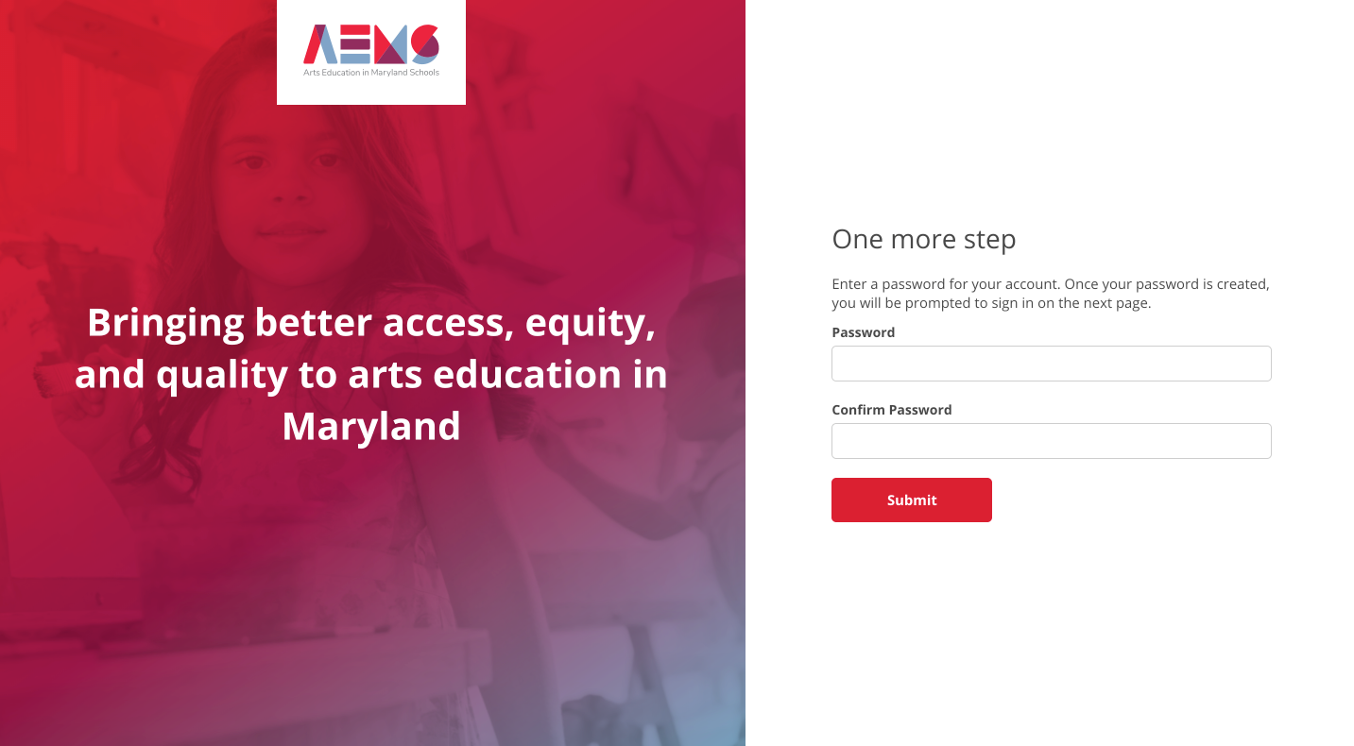

Slide 8
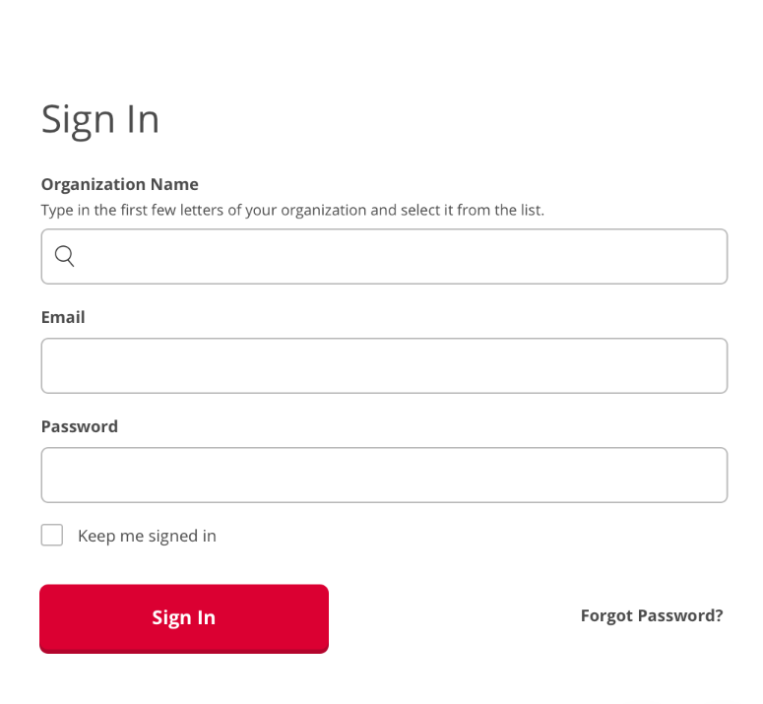

Slide 9
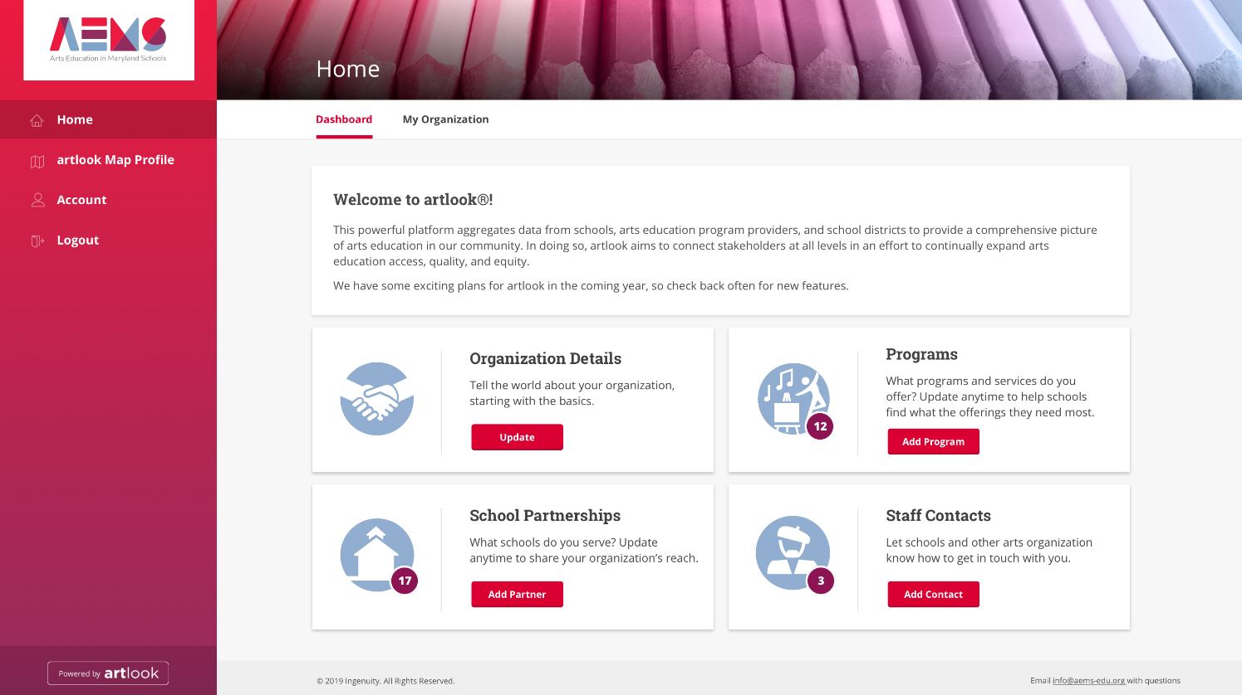

Slide 10
artlook: Admin’s Perspective
Types of artlook admins
Super admins: admin users who have access to all data for all communities (i.e., Ingenuity)
Community admins: admin users who have access to all data within a given community
District admins: admin users who have access to data for a specific school district within a community

Slide 11
artlook Admin Documentation
II. Admin Perspective

Slide 12
artlook: Admin’s Perspective
Setting up your community admin account for the first time
Ingenuity creates your admin user profile in the artlook
Navigate to your admin portal site: neworleans.artlookserver.com
Click “Forgot Password?” on the home page
Create a password for your admin account
Return to the admin portal home page and sign in

Slide 13
artlook: Admin’s Perspective
Setting up additional community admin accounts
As a community admin, you can create additional community admin accounts.
Log in to your community admin account
Click on “Users” in the left-hand navigation bar
Click on “New User” in the top right-hand corner
In the New User form:
Enter the admin’s email address
In the “Role” dropdown, select “admin”
Check the “Create admin only” box
Click “Sign Up”
The newly created admin can then go to your community’s admin portal page and use the “Forgot Password” functionality to set up their password and log in

Slide 14
artlook: Admin’s Perspective
Creating district admin accounts
As a community admin, you can also create district admin accounts for users who should only have admin access for a specific school district within your community.
Log in to your community admin account
Click on “Users” in the left-hand navigation bar
Click on “New User” in the top right-hand corner
In the New User form:
Enter the district admin’s email address
In the “Role” dropdown, select “admin”
Check the “Create admin only” box
Near the bottom of the page, select the appropriate school district
Click “Sign Up”
The newly created district admin can then go to your community’s admin portal page and use the “Forgot Password” functionality to set up their password and log in

Slide 16
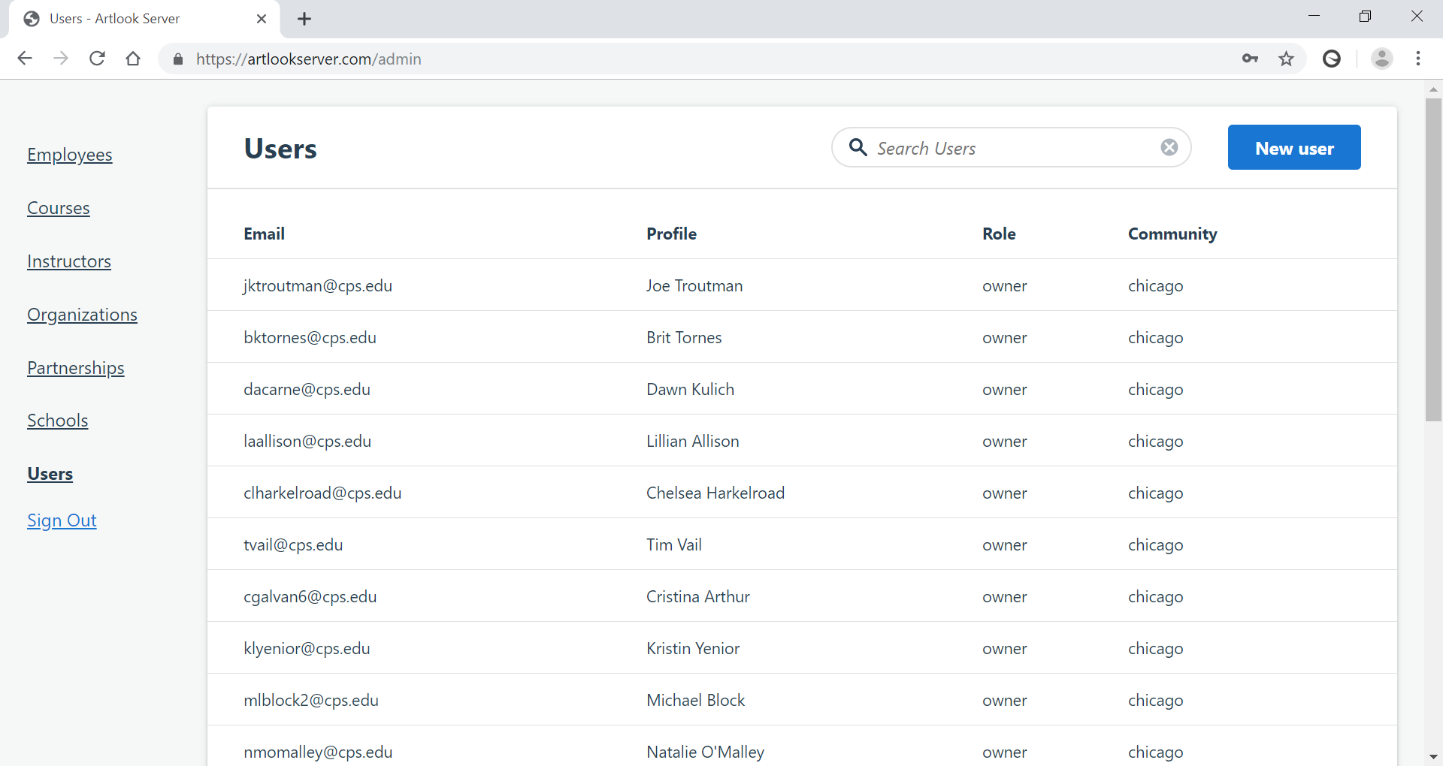

Slide 17
artlook: Admin’s Perspective
Creating new organizations
Occasionally, a new arts organization will reach out to you about artlook and ask you to help them establish a profile. You may also will meet new organizations and teaching artists at events or through mutual contacts.
Do some quick research. Is this really an arts organization?
Click on “Organizations” in the left-hand navigation menu
Search for the organization (and alternative spellings) in the Organizations view.
It is important to avoid duplicate organization records.
Click “New organization”
Provide a name and address for the organization
Street address is not required. City, state, and zip code are required.
Click “Create Organization”

Slide 18
artlook: Admin’s Perspective
Updating organization information
You may need to occasionally update information about an organization, either because the organization asked you to do so or because you noticed a mistake.
Click on “Organizations” in the left-hand navigation menu.
Search for the organization in the Organizations view.
Click on “Edit” for the organization that you are interested in editing.
This gives you the option to update the organization name and/or address.
Enter your change and click “Update Organization”.
You can also click on one of the other columns (e.g., State, Employees, Partnerships) to view data associated with that organization. For example, you can view all the organization’s employees, programs, and school partnerships for a given year.

Slide 19
artlook: Admin’s Perspective
Updating organization information
Details
The Details section allows you to update basic organizational information, including mission statement and website.
To edit details, click on “Edit” for the appropriate year in the details table.
Make your desired edits and click “Update Detail”.
Employees
The Employees section lists all the employees that worked at the organization for a given year.
From here you can edit employee information (remember to select the appropriate year) or you can click “Sign In As” to view that person’s profile as an admin.

Slide 20
artlook: Admin’s Perspective
Impersonate User
This functionality is available for both schools and organizations. It allows you to quickly login to a user’s account and view the portal from their perspective. Through the Impersonate User functionality, you can make edits to that user’s data. Use this with caution!
Sample use cases
A user is confused about how to respond to a specific question in the portal
A user is needs help updating their information
A user reports a bug (e.g., the portal isn’t saving information correctly)
This is also a convenient way to update organization and school information if you are uncomfortable with the admin portal.
You can Impersonate Users through the Users view or by editing an organization in the Organizations view (see previous slide).

Slide 21
artlook: Admin’s Perspective
Creating new schools
Occasionally, a new school may open in your community (or perhaps two neighboring schools will merge into a single school with a unique name and ID). Each year, you will want to pay close attention to how your school district (and, potentially, state board of education) tracks schools so that you can maintain consistency between those sources and artlook (Ingenuity will help you with this process in Y2 of implementation).
Click on “Schools” in the left-hand navigation menu.
Click “New school”.
Provide a name and address for the school.
Select the school’s category
The school’s category determines the version of the survey (i.e., elementary or high school) that will be assigned to the school
Click “Create School”.

Slide 22
artlook: Admin’s Perspective
Updating school information
Sometimes schools open, close, merge, change locations, etc. You may therefore need to occasionally update information about a school in your community. You can do this any time (between school years or in the middle of a school year). Note that the Schools view is a list of schools to have ever existed in your community. (It is, essentially, a list of all the schools in your community’s artlook database.) For each school year, every school can be “Active” or not “Active”.
Some guidelines:
If a school closes in the middle of a school year, then consider keeping that school “Active” for the remainder of that year.
Never delete or destroy a school in the admin portal. If a school closes, you can simply make that school not “Active” for that year.

Slide 23
artlook: Admin’s Perspective
Updating school information
Click on “Schools” in the left-hand navigation menu.
Search for the school in the Schools view.
Click on “Edit” for the school that you are interested in editing.
This gives you the option to update the school name and/or address. Enter your change and click “Update School”.
If you update address information, you do not have to update latitude and longitude--artlook will take care of that for you!

Slide 24
artlook: Admin’s Perspective
Make a school “inactive” for a given school year
Each school in your database can be listed as “active” or “inactive” for a given school year. If a school closed at the end of SY 2017-18, for example, you can set the school as inactive for the 2018-19 school year. When a school is set as inactive, that school will not appear on the artlook frontend for that school year.
Steps to make a school inactive:
Click on “Schools” in the left-hand navigation menu.
Use the search bar at the top of the page to find the school you want to set as “inactive.”
Click on “Edit” for the school you want to set as “inactive.”
Scroll down to the Details section.
In the Details section, click on “Edit” for the school year for which the school needs to be set as “inactive.”
Uncheck the Active box.
Click “Update Detail.”
Watch this video to see how it works: https://drive.google.com/file/d/1yBvIuPdY72AYQ0ZjYJJPqd-hfDL7L8Dc/view?usp=sharing

Slide 25
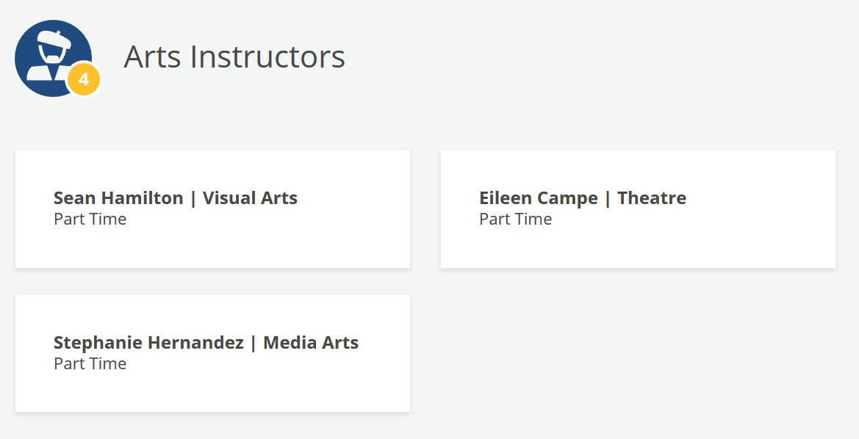
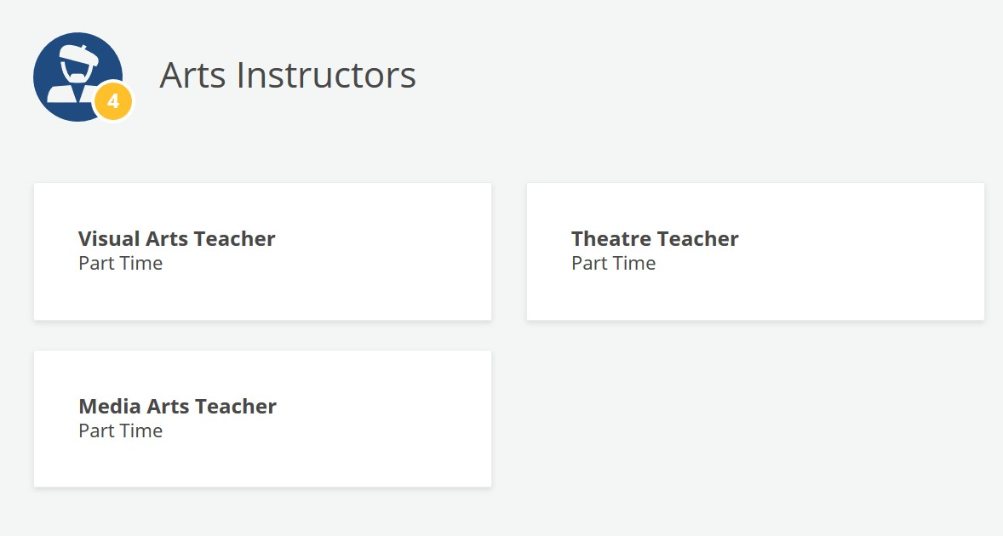
artlook: Admin’s Perspective
Hiding instructor names
If necessary, you can choose to hide instructor names on the public-facing map for a given school. When instructor names are hidden, the instructors section on the school details page will only display the arts discipline and full-time/part-time status of each instructor (see picture below).
Instructor names displayed
Instructor names hidden

Slide 26
artlook: Admin’s Perspective
Hiding instructor names
If necessary, you can choose to hide instructor names on the public-facing map for a given school. When instructor names are hidden, the instructors section on the school details page will only display the arts discipline and full-time/part-time status of each instructor (see picture below).
Steps to hiding instructor names:
Click on “Schools” in the left-hand navigation menu
Click on the school for which you’d like to hide instructor names
Scroll down to the Details section
In the Details section, click on “Edit” for the school year for which you’d like to hide instructors
Check the “Mask PII” checkbox
Click “Update Detail”

Slide 27
artlook: Admin’s Perspective
Creating and onboarding new users
A user is defined as any individual (a person + an accompanying email address) who has a “user” record in the system. There are a few different types of users:
admin users
school users
partner (i.e., organization) users
School and partner users are comprised of three parts:
User profile: Email address, first and last name, encrypted password (established by the user themselves)
Employee record: Connects the user profile to a school or organization and describes the user’s “position” at that school or organization
Employee records are specific to a school year
Users can have more than one employee record at a time
Active?: Is the employee record currently active?

Slide 28
artlook: Admin’s Perspective
Creating and onboarding new users
Before creating a new user, search for that individual’s email in the Users view.
If the email already exists, then work with the user to reset their password. If the email address does not already exist, then create a new user and onboard them to the system.
Creating a new user
Click on “Users” in the left-hand navigation menu
Click “New user” in the top right-hand corner
Enter the user’s email address
Keep owner selected for “Role”
Select the appropriate “Position” (see next slide for a description of each position)
Select the appropriate School or Organization associated with this User
Click “Sign Up”
Reach out to the new user to make sure they were able to access their account
Consider using this email template (click here)

Slide 29
artlook: Admin’s Perspective
Contacts
artlook currently allows for six position types (listed below). These position types will not appear alongside individuals’ names on the public-facing artlook Map. These are simple database “tags” for school and arts organization personnel.
Organizations
Education Contact
Executive Director
Employee
Schools
Arts Liaison
Principal
Teacher
---> The organization’s main education contact
---> The school’s main arts education contact

Slide 30
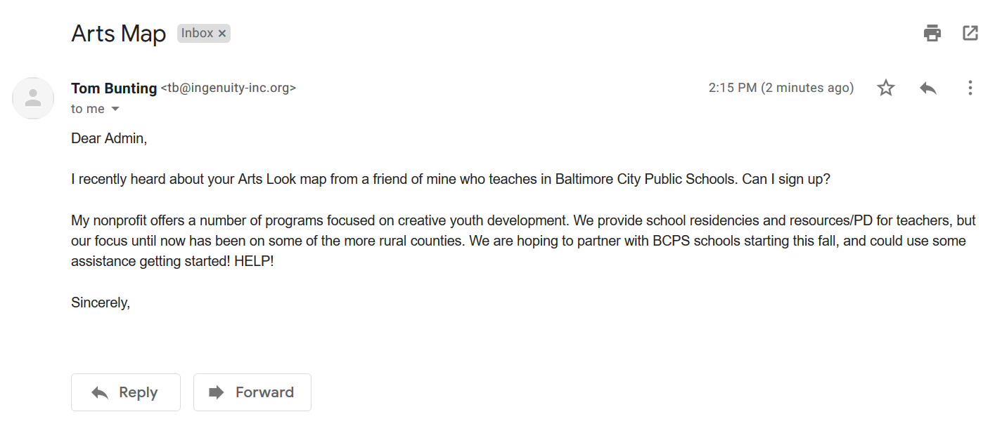
artlook: Admin’s Perspective
Putting it all together!
What are the steps we should take to help this user and onboard them to artlook?

Slide 31
artlook Admin Documentation
III. Troubleshooting with End Users

Slide 32
Troubleshooting with End Users
Troubleshooting Checklist
Read and re-read the user’s email (2 or 3 times)
Identify (for yourself) the specific issue(s) being raised
Use your admin tools to troubleshoot
Admin Portal
Impersonate User
Ask clarifying questions
What browser are they using? Are they on a school wifi network?
Phone call
Reach out to your community admin contact
Two heads are better than one. And this is good for learning!
Reach out to Ingenuity (copy your community contact)

Slide 33
Troubleshooting with End Users
Common challenges and how to solve them!
User can’t reset their password
Check the Users view in the admin portal.
Is their email in artlook? Is the user’s email spelled correctly?
Ask the user to check their spam/junk folder.
Pick up the phone and walk through the password reset process with them.
“Invalid school or organization” message at the sign in page
Ask the user to begin typing their school or organization and then select it from the dropdown menu
Confirm that the user is connected to that school or organization

Slide 34
Troubleshooting with End Users
Common challenges and how to solve them!
Questions about the portal
Pinpoint the specific issue / question the user is facing
User the Impersonate User functionality to view this from their perspective
Updating data for users
Use the Impersonate User functionality, or if you’re comfortable doing so, edit the data directly in the admin portal
Tell the user what you change and instruct them on how they can do this on their own in the future
“In Progress” school survey
Use the Impersonate User functionality to view the school’s progress
Reach out to them about hitting submit!

Slide 35
Platform Engagement

Slide 36
Platform Engagement
Tools and Resources
Strategic Communications Checklist | https://www.ingenuity-inc.org/filebin/artlook_Implementation_Timeline_Worksheet.docx
School Response Rate Dashboard | https://ingenuity-dataviz.shinyapps.io/CreativeCPS-SY2019/
Sample School Survey Communications Plan | https://www.ingenuity-inc.org/filebin/Artlook__AGC_Toolkit/Chicago_Survey_Communications_Plan.pdf
Sample Email Communications | https://www.ingenuity-inc.org/www.ingenuity-inc.org/anygivenchild-toolkit-templates
artlook Handbook | https://www.ingenuity-inc.org/www.ingenuity-inc.org/anygivenchild-toolkit-overviews
artlook Slide Deck Templates | https://www.ingenuity-inc.org/www.ingenuity-inc.org/anygivenchild-toolkit-overviews
Access the full toolkit here: https://www.ingenuity-inc.org/anygivenchild-toolkit

Slide 37
Platform Engagement
 | Target(s) | Responsible Party(ies) | Notes (key messages, dates, milestones / opportunities, etc.)
Partner outreach
District-level outreach
School-level outreach
Funder outreach

