Slide 1
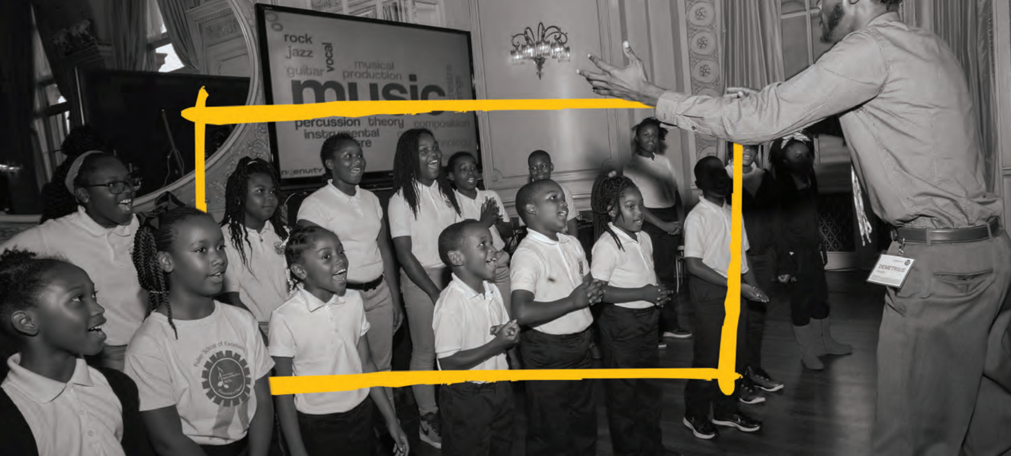

Slide 2
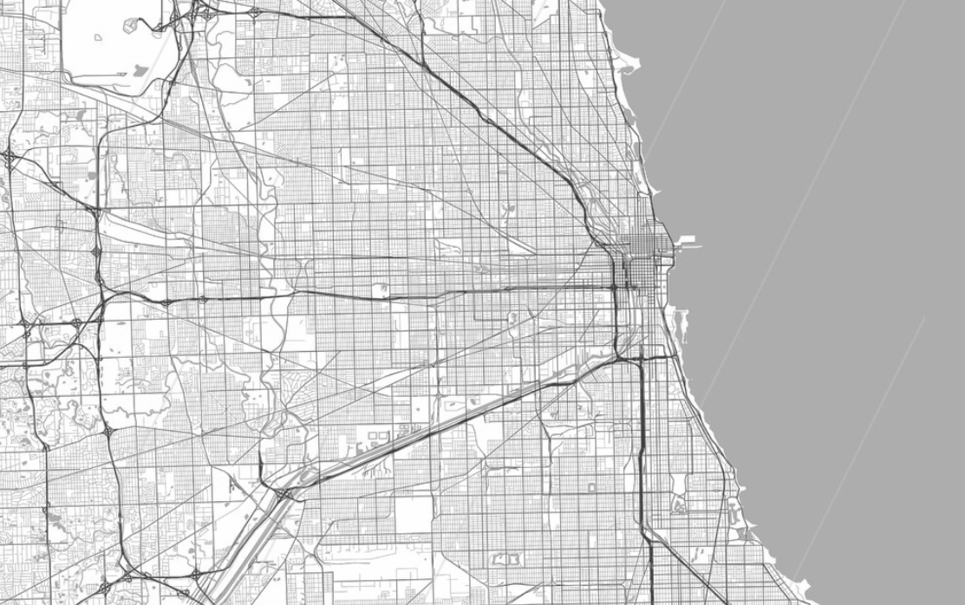
Tracking Arts for Kids Across America
artlook® is a data platform that helps communities across the U.S. track access to the arts for students in their schools.
Real-time insights help support equity in arts staffing, programs, and funding for all students.

Slide 3
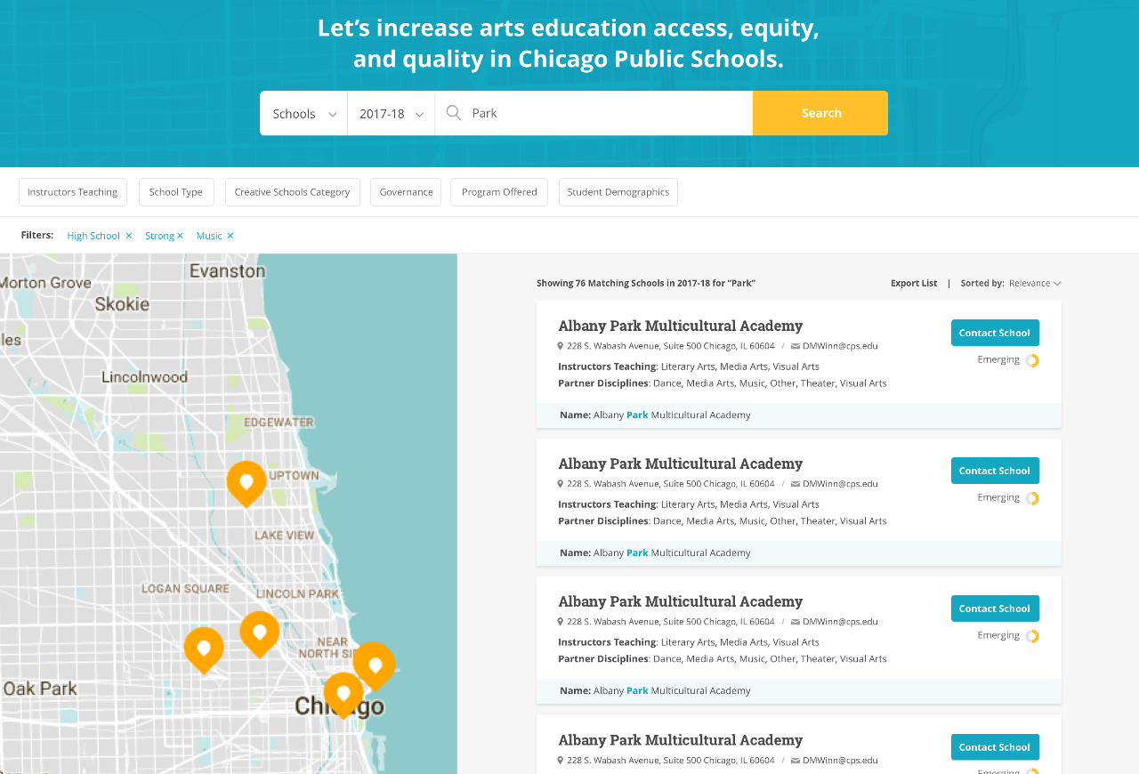
Why artlook?
Even in school districts with robust data systems, there is a limited understanding of how educational programs, resources, and staffing are distributed across schools. These data are not easily shared with external stakeholders like parents, funders, and community members.
Policy, advocacy, and funding decisions are therefore limited by a lack of local data to fuel decisions.

Slide 4
Why artlook?
artlook® is the only collaboration and data sharing platform that allows communities to work collaboratively and strategically to deliver high-quality educational experiences to every child, in every grade, in every school.

Slide 5
How it Works
1. Unify City-Wide Education Data
In each partner community, artlook® brings together data from district operations, community agencies, and individual schools into a single platform to track growth across schools and time.

Slide 6
How it Works
2. Drive Change in Schools and Neighborhoods
artlook’s® free, public mapping tool provides a powerful search engine for principals, teachers, community agencies, funders and even parents. Its insightful matching tool links schools to programs and helps to target resources and connect individuals.

Slide 7
How it Works
3. Inform Decision-Making
artlook’s® data dashboard gives superintendents new insights that help allocate human and capital resources in the arts with greater equity, even targeting neighborhoods and schools with the greatest needs, and tracking progress over time.

Slide 8
Scaling artlook®
artlook® is growing rapidly. Over the upcoming months, the platform’s data collection and dissemination tools will be launched in at least five additional communities.
To support this expansion, artlook has a multitenant platform architecture, which allows each community to make the platform work for their unique needs and context.
Beyond geographic growth, artlook® will launch new features that connect stakeholders and them to activate data to inform decision-making.

Slide 9
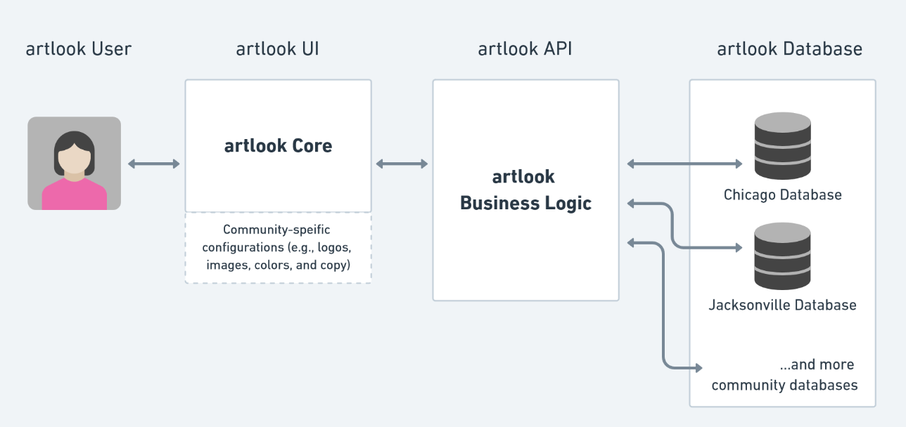
Multitenant architecture

Slide 10
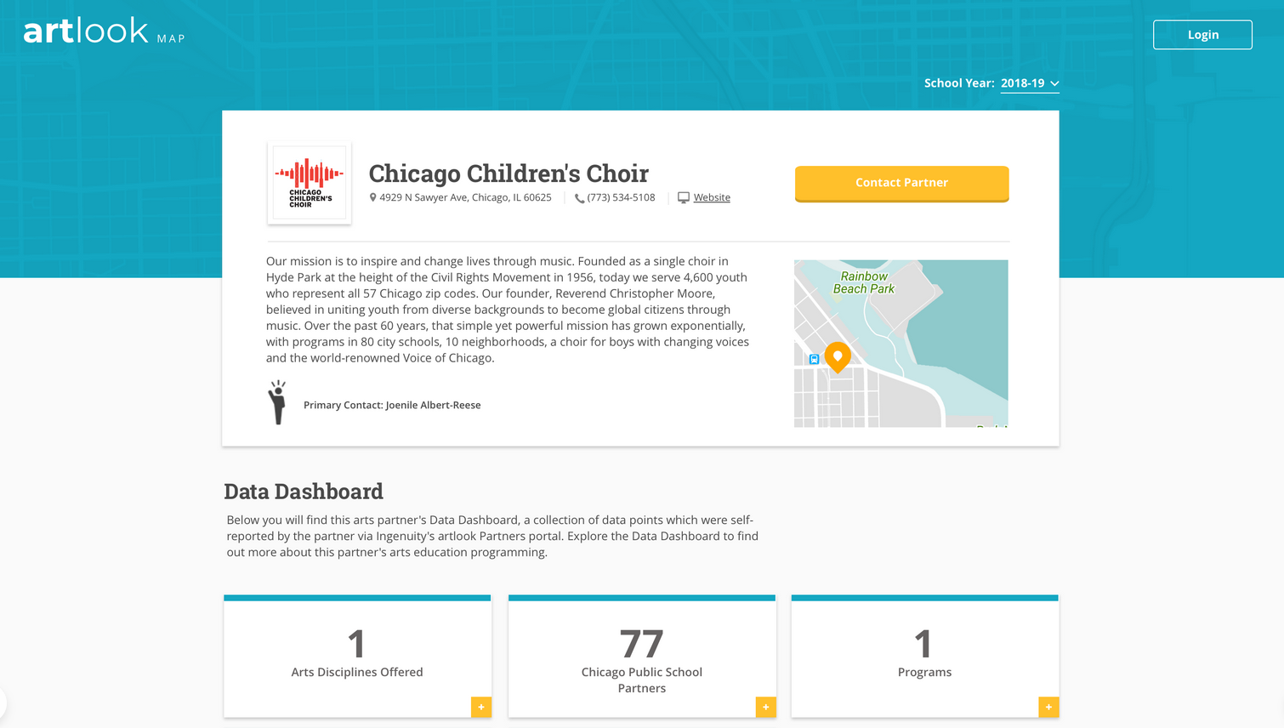
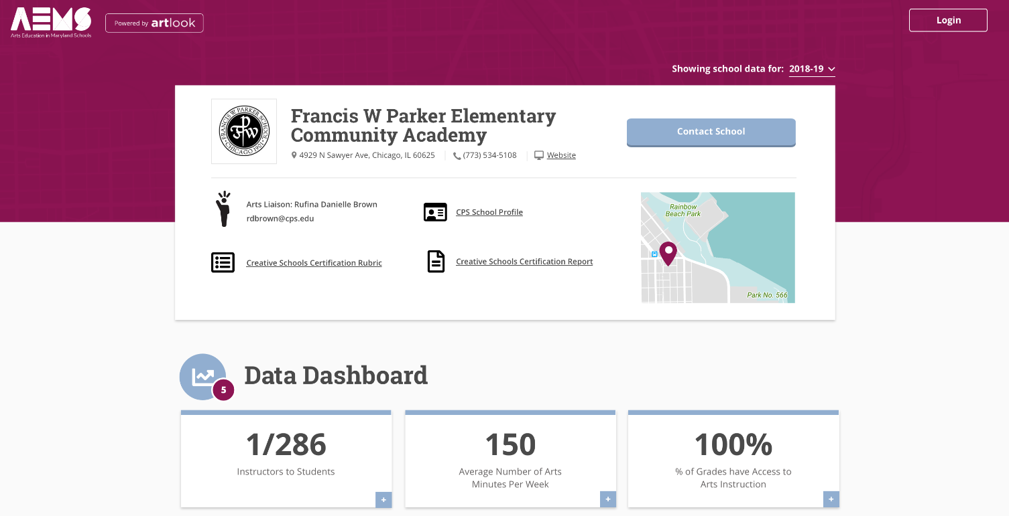
Multitenant architecture
artlook’s multinenant architecture gives communities flexibility to make the platform their own by supporting custom colors, logos, images, and even data fields.

Slide 11
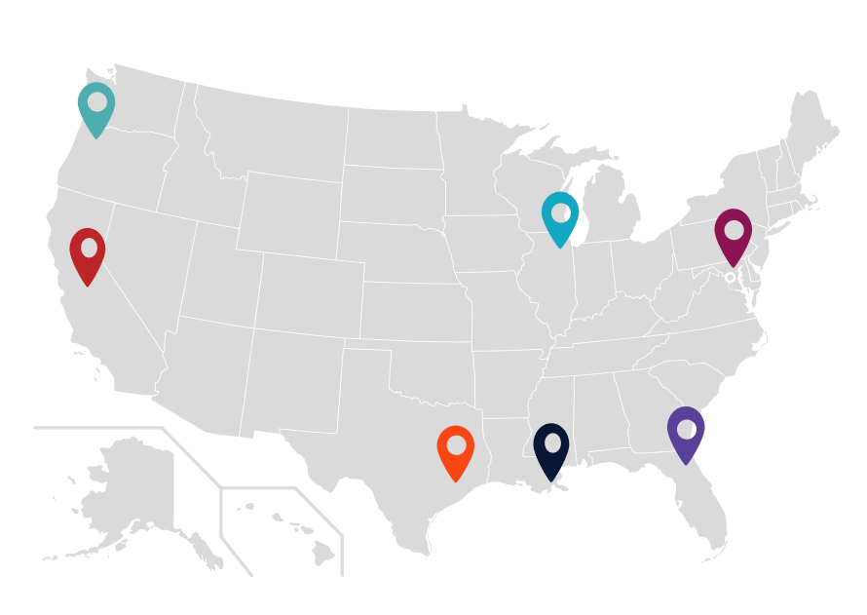
Partner Communities
Launched in 2013 in Chicago Public Schools—the nation’s third largest school system—artlook® has served as a springboard to exponential increases in students’ arts access. In 2019, in part through a partnership with the Kennedy Center for the Performing Arts in Washington, D.C., artlook® launched in six more U.S. cities and one state. The goal is to expand arts education access, quality, and equity for every child, in every grade, in every school.

Slide 12
Expanded Functionality
More Cities Joining
Proven, easy-to-use portals for schools and arts organizations to enter uniform data
Analytics Dashboard
Ability to track progress and compare measures over time and place
New Features
New features available to all artlook users in all communities as they are developed and released
Community of Practice
Knowledge sharing among a growing community of backbone agencies
Research & Analysis
Inform local, state, and federal arts education policy and funding
Improved Policy for All
Data is leveraged to advocate and improve arts education policies and funding at the local, regional and national level.

Slide 13
Questions
Paul Sznewajs
Executive Director
ps@ingenuity-inc.org
Steve Shewfelt
Director of Data & Research
ss@ingenuity-inc.org
Learn More!
ingenuity-inc.org
youtu.be/8gLRzuQRmUA

